Slide 1
MAERB Activities:
July 2024 – June 2025
Program Outcomes: Calendar Year 2023

Slide 2
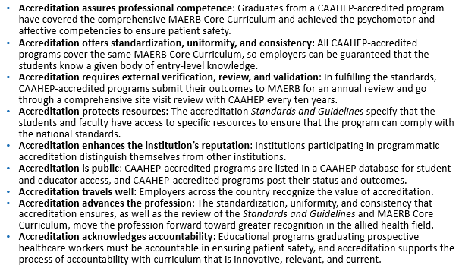
Virtues of Accreditation
Notes:
While we traditionally conclude presentations with the Virtues of Accreditation, in this instance it is productive to begin with those virtues, as the data in this report reinforce those virtues.

Slide 3
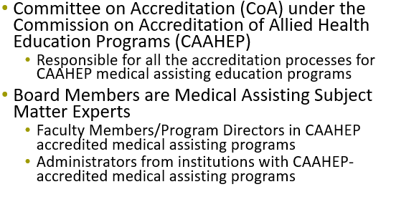
Medical Assisting Education Review Board
Notes:
As a brief reminder, MAERB exists under the auspices of CAAHEP and conducts all the accreditation activities both for the CAAHEP-accredited programs and the medical assisting programs applying for initial accreditation. The Board consists of subject-matter experts in medical assisting education.

Slide 4
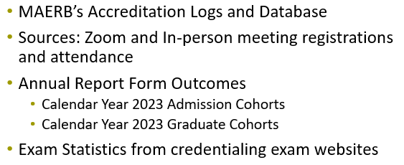
Data Sources
Notes:
The information provided in this was derived from a variety of sources that are outlined above. As indicated, the information reports upon the activities of the community with MAERB, and it demonstrates the involvement of all the parties. The data about MAERB activities outlined in this report focuses on the MAERB’s fiscal year, from July 1, 2024 – June 30th, 2025. However, it should be noted that the data about program outcomes and exams is based on the calendar year 2023, and this distinction will be indicated throughout the report.

Slide 5
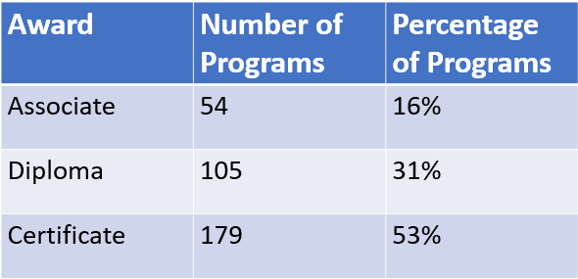
CAAHEP-Accredited
Medical Assisting Awards
Notes:
The community of CAAHEP-accredited medical assisting programs is a diverse one, as medical assisting programs have a variety of different awards, depending upon the needs of the community and the requirements of the Program Sponsor.

Slide 6
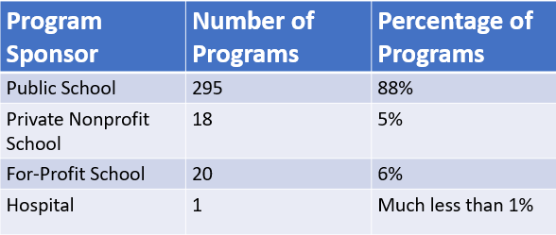
CAAHEP-accredited Medical Assisting Program Sponsors
Notes:
There is variety as well in the institutions that sponsor medical assisting programs, while the strong majority, however, is public post-secondary institutions.

Slide 7
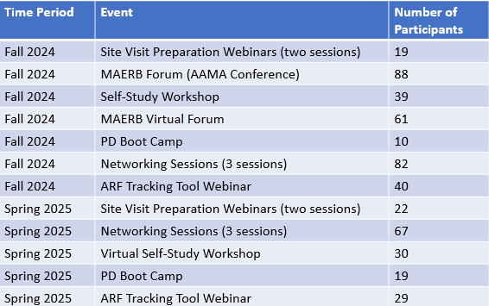
MAERB Educational Activities
506 Participants
Notes:
Accreditation requires a great deal of knowledge to ensure that an individual program can easily demonstrate its compliance with the CAAHEP Standards and Guidelines. The MAERB sponsors many educational events throughout the academic year to ensure that Program Directors, instructional staff, and Deans/Supervisors overseeing CAAHEP-accredited medical assisting programs have the information that they need. As the numbers here indicate, there has been and continues to be robust program participation in the various events that are offered by MAERB. This participation demonstrates the dedication of the CAAHEP-accredited medical assisting community.

Slide 8
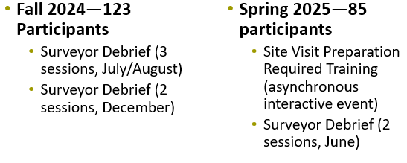
Site Surveyor Educational Activities: 208 Participants/74 Site Surveyors
Notes:
Accreditation is based upon peer review. And so, the Site Surveyors who conduct the comprehensive review site visits and ensure that those programs demonstrate compliance are medical assisting program directors, instructional staff, and administrators who serve in or oversee CAAHEP-accredited medical assisting programs. In addition to an in-depth initial training on every set of Standards and Guidelines, surveyors take part in a variety of trainings through the year, and the events are outlined above. They are committed to serving medical assisting education programs and accreditation, and they do so as volunteers who are invested in ensuring that they are knowledgeable and informed.

Slide 9
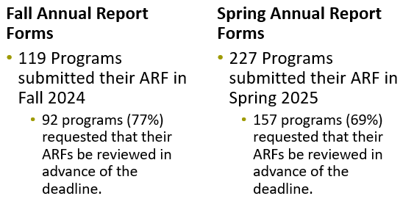
Annual Report Form (ARF)
Notes:
For the 2024 ARF, the MAERB Office started a robust campaign for programs to request that their ARFs be reviewed prior to submission. The MAERB Office extended the deadline for submitting the ARF by two weeks, so Program Directors had five weeks to prepare their ARF and request a review. A substantial number of the programs received an early review, which eliminated later unlock fees.

Slide 10

Outcome-Based Accreditation
Notes:
CAAHEP is committed to outcomes-based accreditation. Every year, all CAAHEP-accredited programs report their outcomes (either in the fall or spring), based upon the previous calendar year. For example, the outcomes that were submitted in either fall 2024 or spring 2025 were based on the admission and graduation cohorts for calendar year 2023. The outcomes are represented as percentages, and each outcome has a specific threshold that programs need to meet, which varies from outcome to outcome. The information that you will find in the outcomes section of this dashboard is based upon the calendar year 2023.

Slide 11
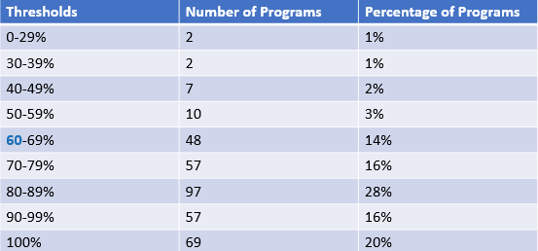
Retention
2023 Admission Cohorts
Notes:
The retention outcome focuses on, first, the integrity of the program in admitting students who can achieve the goals of the medical assisting program as well as the support that the program offers for student success.
The threshold for retention is at 60% or above. In other words, a program needs to retain at least 60% of its students to meet the threshold. So, for example, a program that admits 100 students needs to graduate at least 60 students to meet the threshold. As this chart indicates, 93% of the CAAHEP-accredited programs were either at or above the required threshold in the calendar year 2023.
The threshold percentage is highlighted in blue.

Slide 12
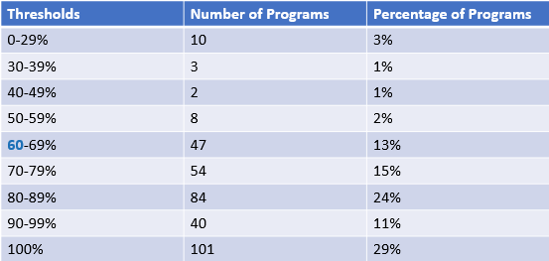
Job Placement
2023 Graduate Cohorts
Notes:
The job placement outcome is an important measurement that focuses on the alignment of the program with the needs of the profession and work environment.
The threshold for job placement is 60% or above. So, at least 60% of students need to either be 1) employed as a medical assistant or in a related field, 2) continue their education in a health-related profession, or 3) enter directly into the military. For example, if a program has a graduate cohort of a 100 students, at least 60 students need to be “positively placed.” As this chart indicates, 93% of CAAHEP-accredited medical assisting programs were either at threshold or above threshold in job placement for the calendar year 2023.
The threshold percentage is highlighted in blue.

Slide 13
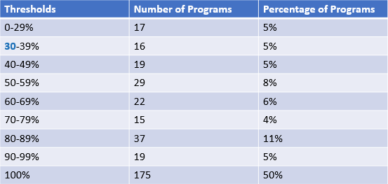
Graduate Survey Participation
2023 Graduate Cohorts
Notes:
Every program depends upon the participation of its graduates to best evaluate the program, and CAAHEP-accredited programs are required to administer a graduate survey to all its graduates and must reach the threshold of at least a 30% return rate of those surveys; in other words, at least 30% of the graduates are required to respond to the graduate survey. If, for example, a program has a 100 graduates, at least 30 or more need to complete the survey. As this chart indicates, 95% of CAAHEP-accredited medical assisting programs were either at or above threshold in graduate survey participation in calendar year 2023.
The threshold percentage is highlighted in blue.

Slide 14
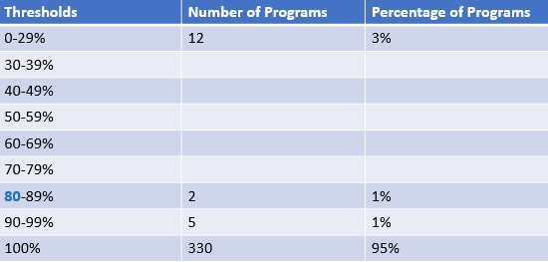
Graduate Survey Satisfaction 2023 Graduate Cohorts
Notes:
The outcome for graduate satisfaction is linked to the graduate survey participation. The surveys administered record the graduates’ satisfaction with the CAAHEP-accredited medical assisting program; the threshold is at 80% or above. So, at least 80% of the graduates who participated in the survey need to indicate that they were satisfied with the program. In other words, if there are 100 graduates, at least 80 of those graduates need to indicate that they are satisfied. As this chart shows, 97% of the programs were above threshold in graduate satisfaction for the calendar year 2023.
The threshold percentage is highlighted in blue.

Slide 15
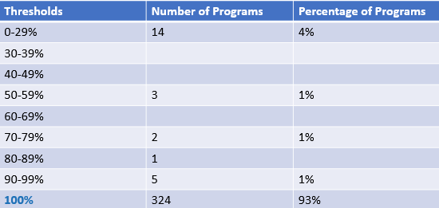
Employer Surveys Sent
2023 Graduate Cohorts
Notes:
The employers of the graduates are an important community of interest. CAAHEP-accredited programs are required to send surveys to all the employers who have hired graduates. The threshold for sending out the employer surveys is 100%. So, programs are required to send out the surveys to 100% of the employers who have hired graduates in the field of medical assisting or a related field. If, for example, a program has a 100 graduates, and 90 of those graduates received positions as medical assistants or a related field, the program needs to send out 90 surveys. As this chart indicates, 93% of CAAHEP-accredited medical assisting programs have met the 100% threshold for sending out employer surveys for the calendar year 2023.
The threshold percentage is highlighted in blue.
NOTE: The one program in the 70-79 percentile represents less than .5% of the population, so it is not calculated in the equation.

Slide 16

Employer Satisfaction
2023 Graduate Cohorts
Notes:
The outcome for employer satisfaction is linked to an outcome with no defined threshold. Due to the difficulty of obtaining surveys from employers, there is no threshold for employer participation. There is, however, a threshold for employer satisfaction based upon the percentage of employers who returned the surveys. The surveys administered record the employers’ satisfaction with the CAAHEP-accredited medical assisting program, and the threshold is at 80% or above. So, at least 80% of the employers who participated in the survey need to indicate that they were satisfied with the program’s graduates. In other words, if there are 100 employer surveys that were returned, at least 80 of those surveys need to indicate satisfaction with the hired graduate. As this chart indicates, 89% of the programs were above the 80% threshold for the calendar year 2023.
The threshold percentage is highlighted in blue.
NOTE: The one program in the 70-79 percentile and the 90-99% percentile represent individually less than .5% of the population, so it is not calculated in the equation.

Slide 17
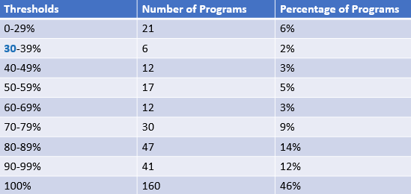
Exam Participation
2023 Graduate Cohorts
Notes:
Graduates’ participation in a national credentialing exam is another important outcome. Even though there are some regions of the country where employers do not emphasize the need for a national credentialing exam, graduate participation in one of the 5 qualifying exams is an important external measure for the quality of the program. MAERB requires a 30% threshold for graduate participation in a credentialing exam. To meet the threshold, at least 30% of the graduates of the program need to take one of the exams. For example, a program with 100 graduates must have at least 30 of those graduates take an exam. As this chart indicates, 94% of the programs were above threshold for exam participation for calendar year 2023.
The threshold percentage is highlighted in blue.

Slide 18
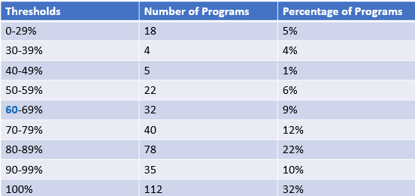
Exam Passage
2023 Graduate Cohorts
Notes:
In addition to 30% graduate participation in an exam, graduate passage of a national credentialing exam is a vitally important outcome. The outcome threshold for exam passage is 60%. For a program to meet this threshold, 60% of the students must pass at least one of the exams that they take. For example, if there are 100 graduates from a program, and 50 of them take a credentialing exam, then 30 of those students must pass the exam to meet the threshold. As the chart above indicates, 84% of the CAAHEP-accredited program were above threshold for the calendar year 2023.

Slide 19
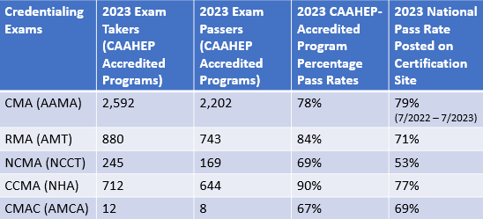
National Exam Passage Rates, 2022
Notes:
The outcomes reported on the MAERB Annual Report Form (ARF) represent the achievements of the CAAHEP-accredited medical assisting programs. It is helpful to contextualize the achievements within the larger national environment, particularly with exam passage. As the chart above indicates, the passage rate of CAAHEP-accredited programs is roughly the equivalent to or exceeds the national passage rate of those exams, in some instances significantly. The high performance of the graduates of CAAHEP-accredited programs demonstrates the effectiveness of the academic requirements of a CAAHEP-accredited program.

Slide 20
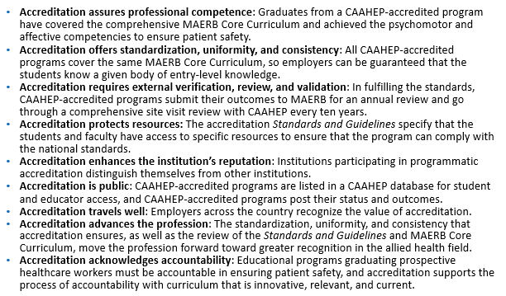
Virtues of Accreditation
Notes:
Repetition is an educational technique, so this PowerPoint report will close with the Virtues of Accreditation, just as it began.

